Slide 1


Slide 2

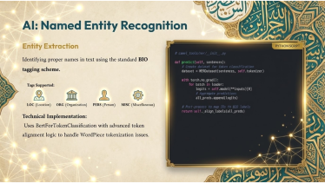



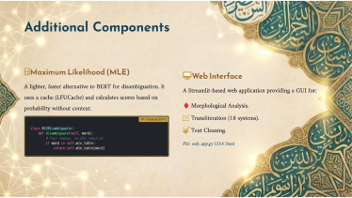
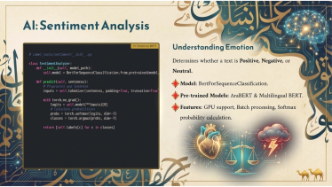

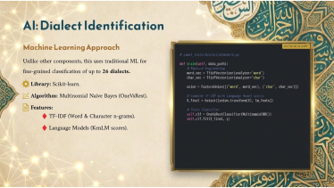
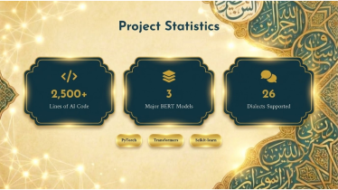


Slide 3


Test your knowledge of FC Barcelona's legendary players while learning practical applications of C++ data structures.
Sajad Kadhim Kareem Abood

Slide 4

Game Overview
What is Barcelona Trivia?
Learning Objectives
An interactive quiz game testing your knowledge of FC Barcelona.
Test football knowledge about Barcelona's history.
Understand practical applications of Stacks and Queues.
Uses advanced C++ data structures for engaging gameplay.
Explore object-oriented design in C++.

Slide 5


Player Class Implementation
Key Properties
Member Functions
name (string)
Constructor
jerseyNumber (integer)
getName()
age (integer)
getJerseyNumber()
getAge()
Benefits
Encapsulated data
Controlled access
Scalable design

Slide 6







Quiz Class Design
User Interface
Interactive question display and input handling
Game Logic
Question management and answer validation
Data Storage
Player records and question organization

Slide 7


Game Logic Implementation
Create Data Structures
Initialize Stack for questions and Queue for incorrect answers.
Load Questions
Push all players onto the Stack in LIFO order.
Present Questions
Pop questions from Stack and display to user.
Track Results
Store incorrect answers in Queue for later review.

Slide 8

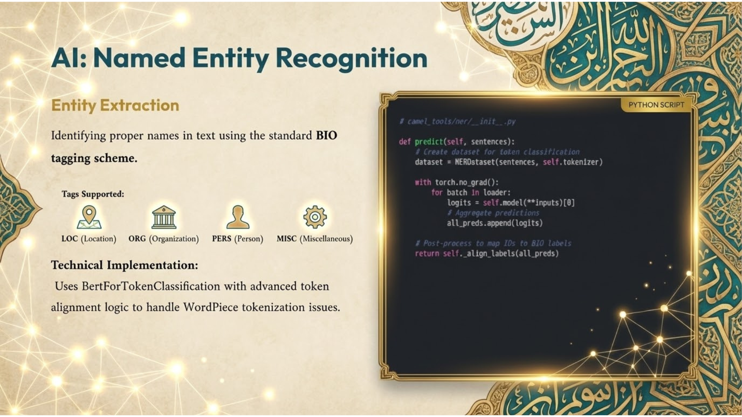




Answer Validation
Question Display
User Input
Validation
Result Tracking
Collect user's guesses for the player's details.
Compare input with actual player data.
Store incorrect answers for review session.
Show player name and prompt for age and jersey number.

Slide 9
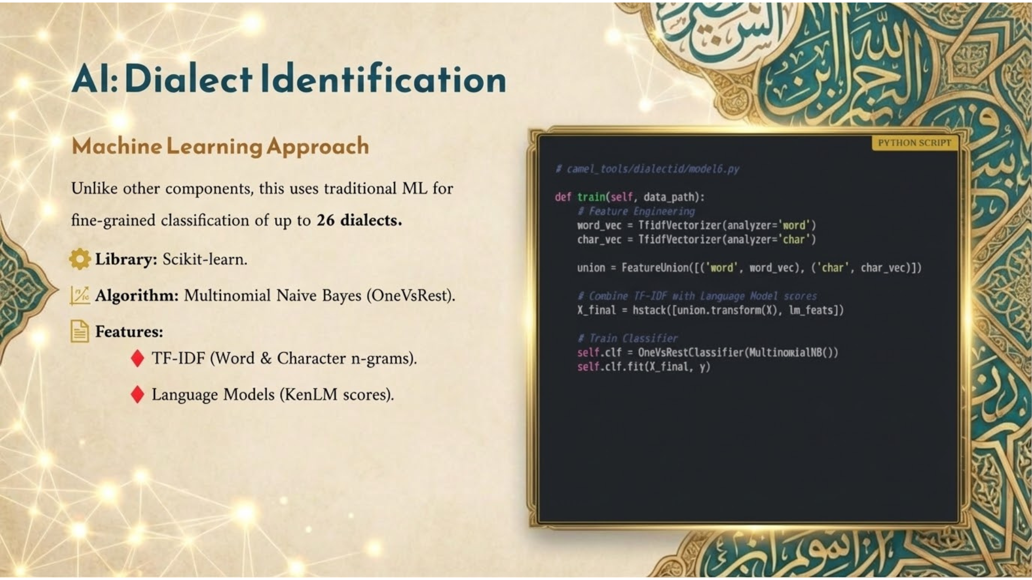

main() Function Workflow
1
Create Player Data
Initialize a list of Barcelona players with their details.
2
Initialize Quiz
Create a Quiz object with the player list.
3
Start Game
Call playGame() to begin the interactive quiz.
4
Display Results
Show performance summary and incorrect answers.

Slide 10









Data Structure Benefits
Stack (LIFO)
Queue (FIFO)
Adds element of surprise for challenge questions.
Enables systematic review of incorrect answers.
Classes
Extensibility
Provides organization and encapsulation.
Easily add players or question types.

Slide 11

Data Structure Benefits
Stack (LIFO)
Queue (FIFO)
Adds element of surprise for challenge questions.
Enables systematic review of incorrect answers.
Classes
Extensibility
Provides organization and encapsulation.
Easily add players or question types.

Slide 12

Data Structure Benefits
Stack (LIFO)
Queue (FIFO)
Adds element of surprise for challenge questions.
Enables systematic review of incorrect answers.
Classes
Extensibility
Provides organization and encapsulation.
Easily add players or question types.

